Slide 1
The Philosophical Mindscape of a CogSci Student: A Journey of Ideas
By: Christoffer L. Olesen

Slide 2
General Overview

Slide 3
General Overview
Introduction

Slide 4
General Overview
Introduction
General overview

Slide 5
General Overview
Introduction
General overview
The Journey

Slide 6
General Overview
Introduction - Past
General overview - Present
The Journey - Future

Slide 7
General Overview
Introduction - Past - Being
General overview - Present - Becoming
The Journey - Future - Nothing

Slide 8
General Overview
Introduction - Past - Being
General overview - Present - Becoming
The Journey - Future - Nothing
THESIS SYNTHESIS
ANTITHESIS

Slide 9
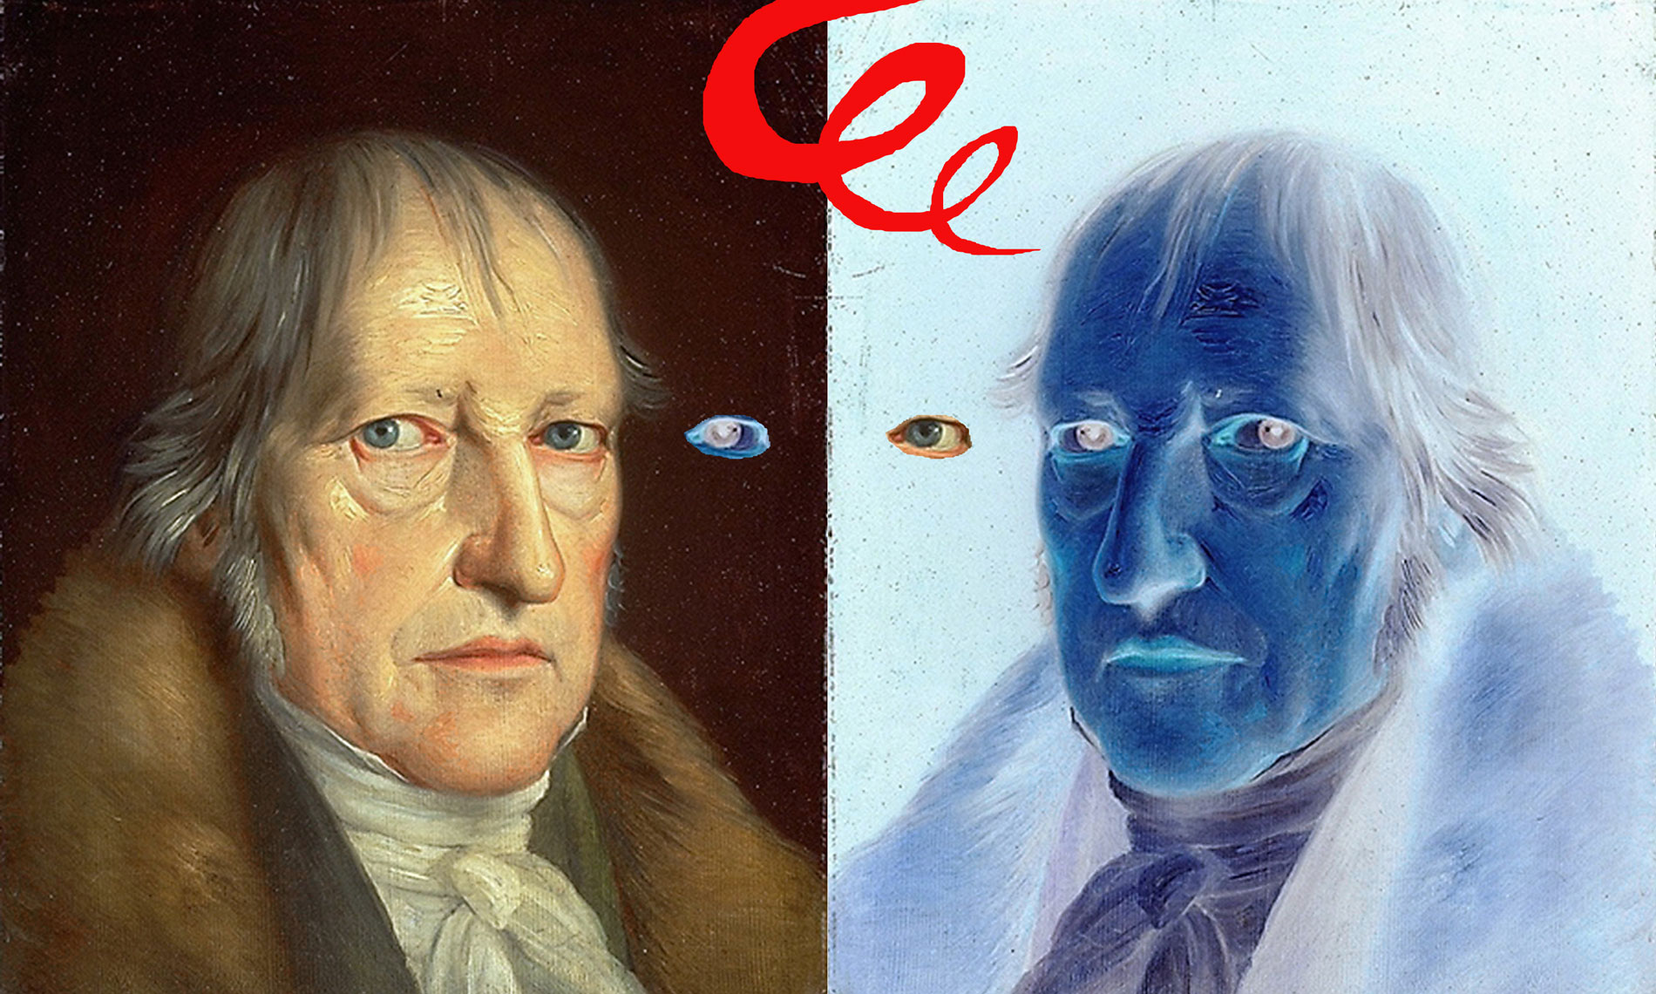
General Overview
Introduction - Past - Being
General overview - Present - Becoming
The Journey - Future - Nothing
Georg Wilhelm Friedrich Hegel
THESIS SYNTHESIS
ANTITHESIS

Slide 10
General Overview
Introduction - Past - Being
General overview - Present - Becoming
The Journey - Future - Nothing
Georg Wilhelm Friedrich Hegel
THESIS SYNTHESIS
ANTITHESIS

Slide 11

General Overview
Introduction - Past - Being
General overview - Present - Becoming
The Journey - Future - Nothing
Georg Wilhelm Friedrich Hegel
THESIS SYNTHESIS
ANTITHESIS

Slide 12
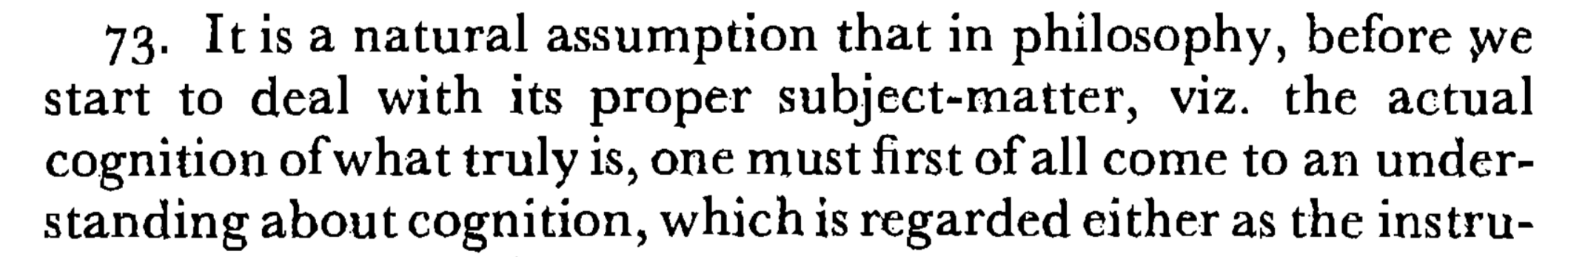
General Overview
Introduction - Past - Being
General overview - Present - Becoming
The Journey - Future - Nothing
THESIS SYNTHESIS
ANTITHESIS

Slide 13
LET THE JOURNEY BEGIN
First stop: Lisbon, 1755

Slide 14
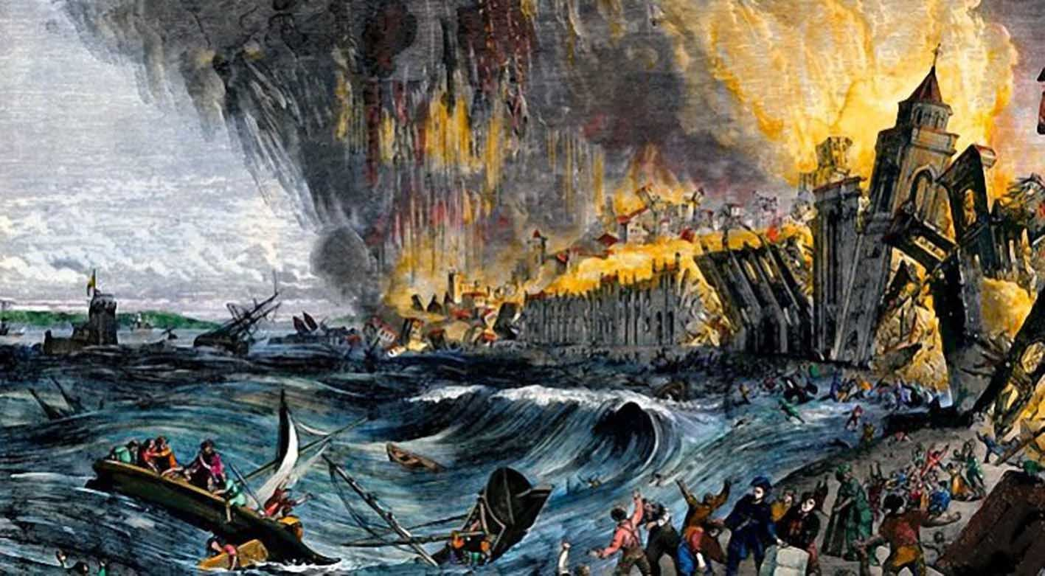
The Lisbon Earthquake Of 1755

Slide 15
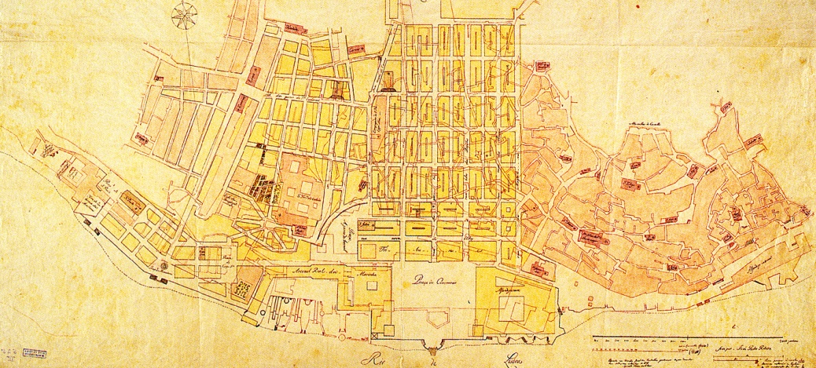
The Lisbon Earthquake Of 1755

Slide 16
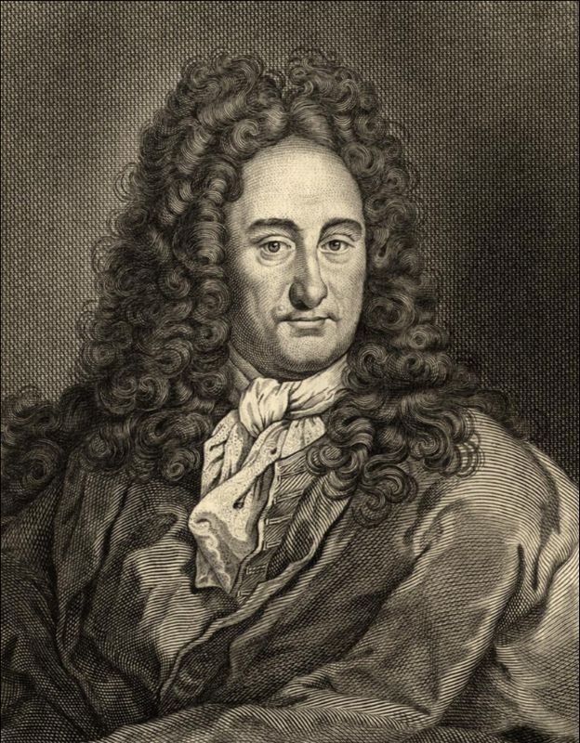
Gottfried Wilhelm Leibniz

Slide 17
1. God has the idea of infinitely many universes.
2. Only one of these universes can actually exist.
3. God's choices are subject to the principle of sufficient reason, that is, God has reason to choose one thing or another.
4. God is good.
5. Therefore, the universe that God chose to exist is the best of all possible worlds
Gottfried Wilhelm Leibniz

Slide 18
Lets have a Stephen Fry moment
https://www.youtube.com/watch?v=-suvkwNYSQo
Notes:
https://www.youtube.com/watch?v=-suvkwNYSQo

Slide 19
Well Stephen, I guess that all other possible worlds would be even more miserable. Bone cancer in children is maybe just a necessary evil and God is actually a good guy for choosing the least evil world possible.
Gottfried Wilhelm Leibniz

Slide 20
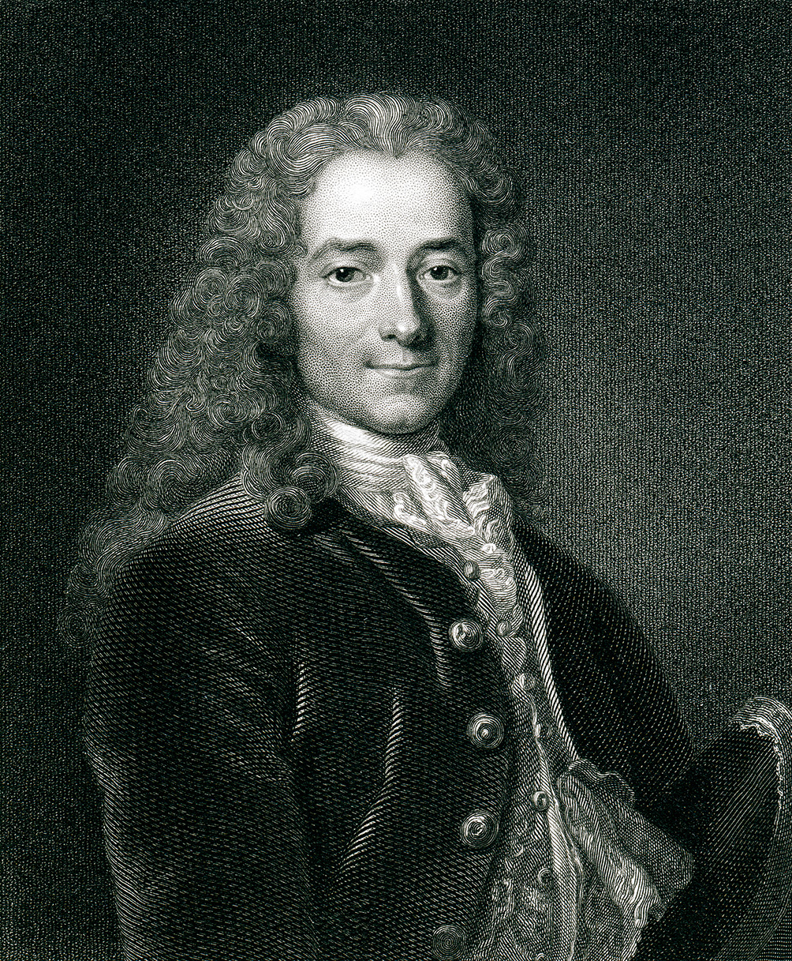
Gottfried Wilhelm Leibniz
Voltaire

Slide 21
Dude, I know you have been dead for 39 years, but did you hear what happened in Lisbon? This cannot be the best of all possible worlds!
I’m gonna make so much fun of you now!
Gottfried Wilhelm Leibniz
Voltaire

Slide 22
God vs. Nature
The notion of nature as something apart from God
Some things are not the product of a will
Nature is neither good or evil

Slide 23
God vs. Nature
The notion of nature as something apart from God
Some things are not the product of a will
Nature is neither good or evil
It changes the way we see ourselves in relation to our environment

Slide 24
NEXT STOP
Århus, December 2017

Slide 25
Speculative Realism
An umbrella term for some contemporary philosophical movements
The notion that that nature doesn’t care about us
Trying to brake down the barrier between subject and object
Thinking about the world as it is in it self

Slide 26
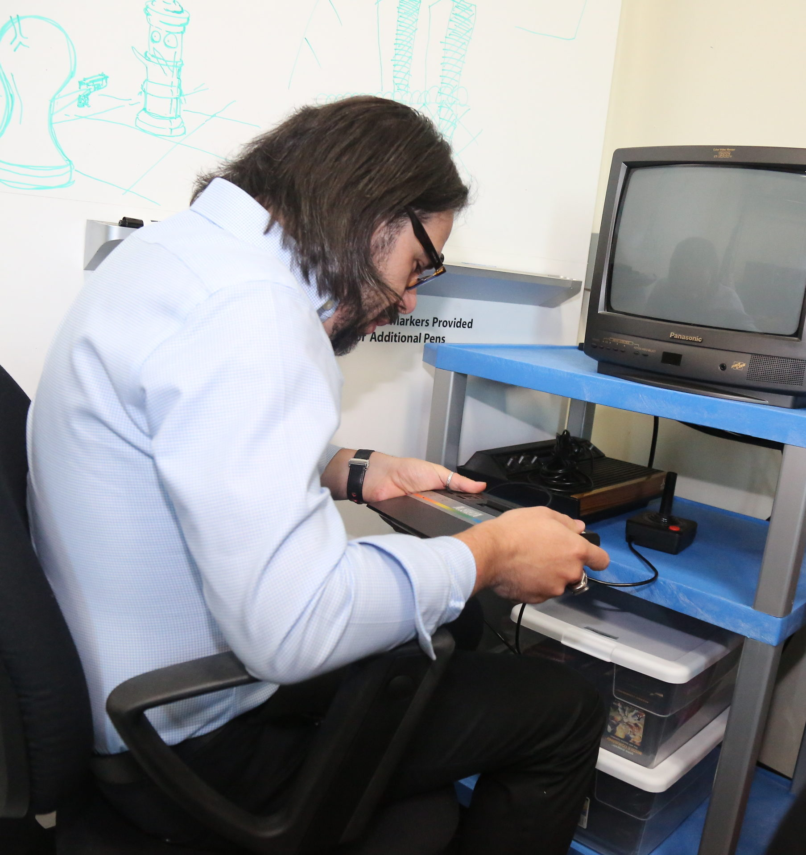
Speculative Realism
What is it like to be a thing?
Can you know anything about a thing as it is in it self?
Ian Bogost

Slide 27
YOU KANT

Slide 28
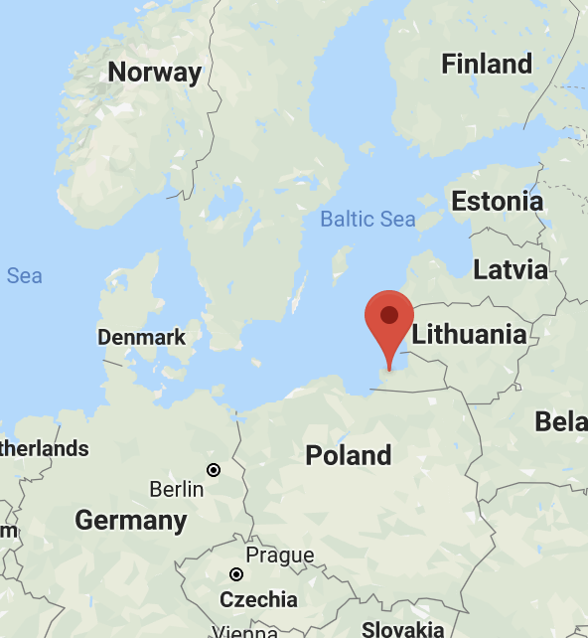
NEXT STOP
Königsberg, 1781
Notes:
Now Kaliningrad

Slide 29
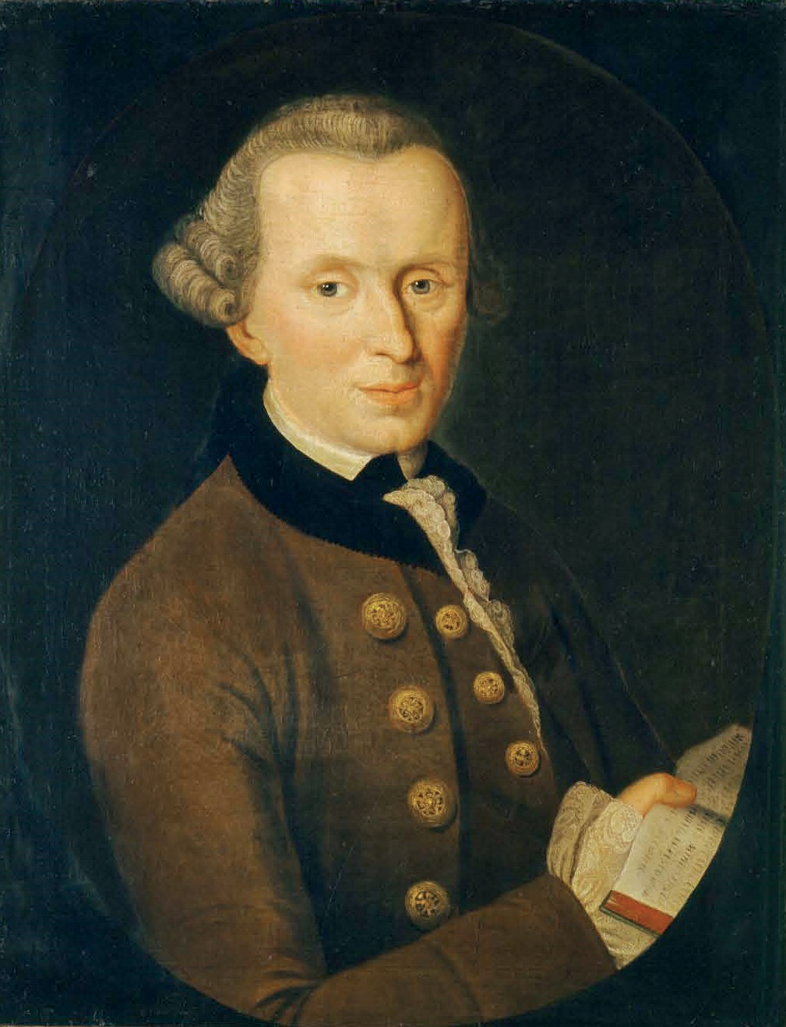
Immanuel Kant

Slide 30
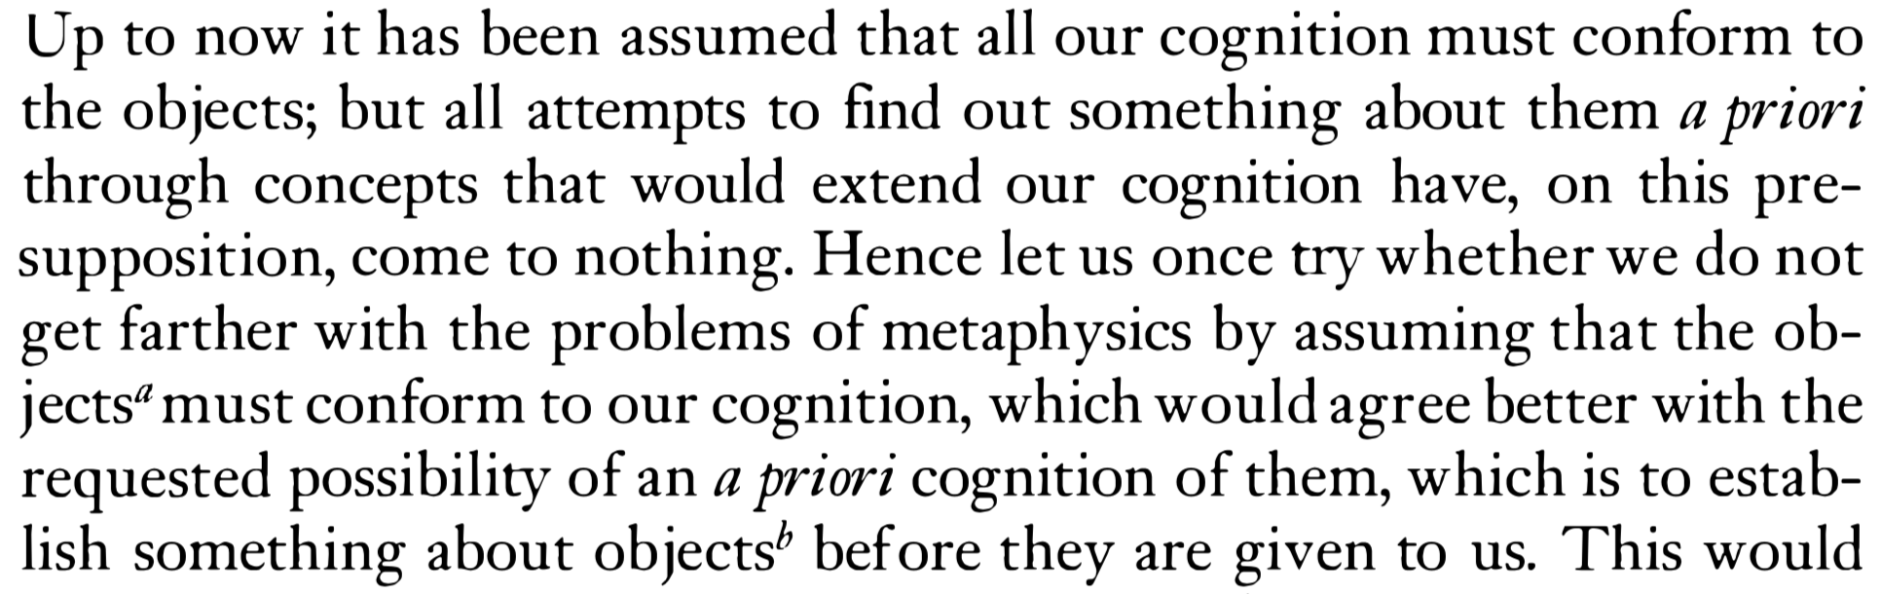
Immanuel Kant

Slide 31

Cognition conforming to the objects
Immanuel Kant

Slide 32
Objects conforming to cognition
WORLD
Immanuel Kant

Slide 33
Judgements
a priori | a posteriori
Analytic | Synthetic
Logical judgement
Objects conforming to cognition
WORLD
Immanuel Kant

Slide 34
Judgements
a priori | a posteriori
Analytic | Synthetic
Things as they appear for us
Objects conforming to cognition
Things as they are in themselves
Immanuel Kant

Slide 35
Judgements
a priori | a posteriori
Analytic | Synthetic
Things as they appear for us
Objects conforming to cognition
Things as they are in themselves
Immanuel Kant

Slide 36
Judgements
a priori | a posteriori
Analytic | Synthetic
Things as they appear for us
Objects conforming to cognition
Things as they are in themselves
Immanuel Kant

Slide 37
Judgements
a priori | a posteriori
Analytic | Synthetic
Things as they appear for us
Objects conforming to cognition
Things as they are in themselves
Immanuel Kant

Slide 38
Judgements
a priori | a posteriori
Analytic | Synthetic
Kant as he is in himself
Things as they appear for us
Objects conforming to cognition
Things as they are in themselves
Immanuel Kant

Slide 39
NEXT STOP
Viby J, October 2019

Slide 40
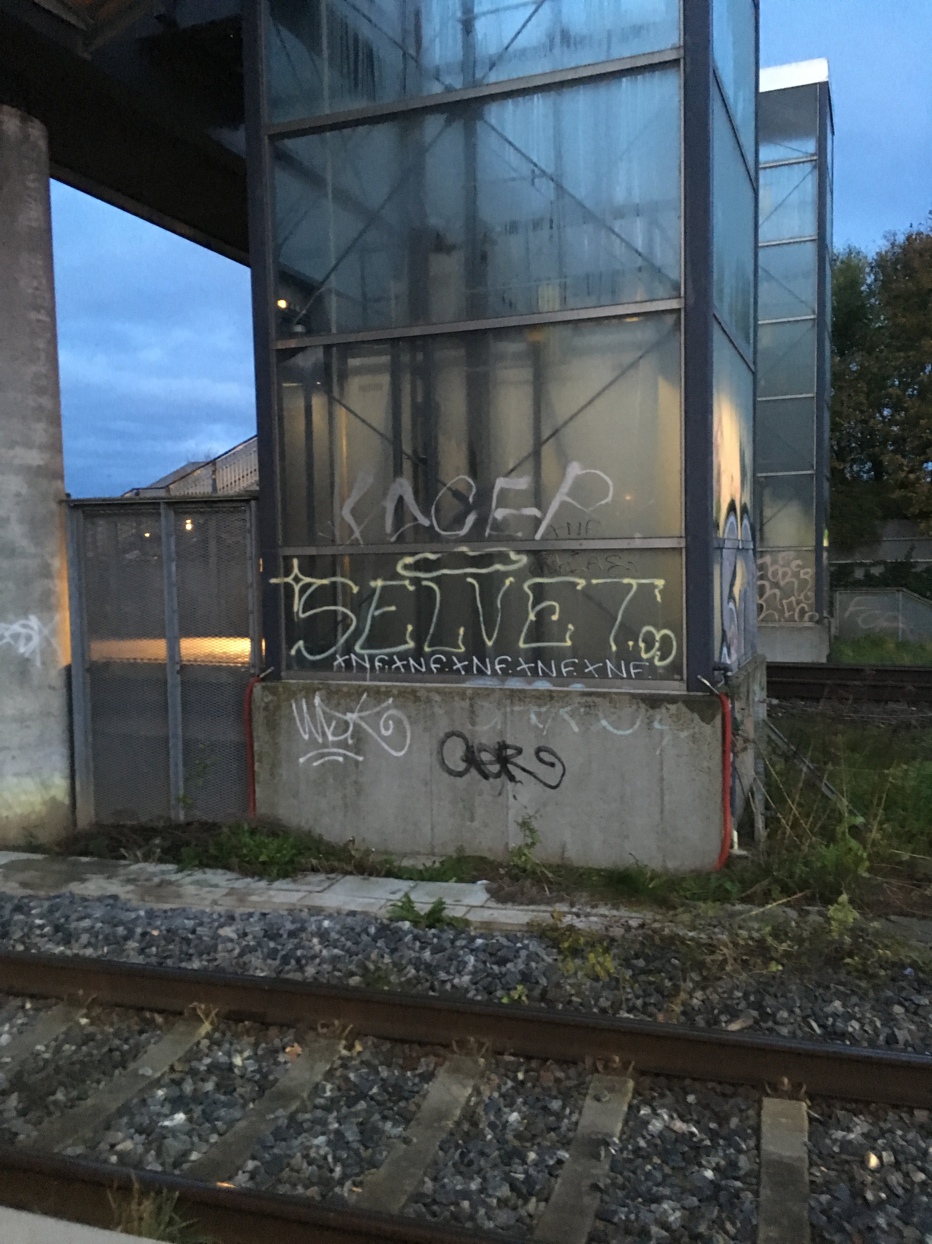
Unknow rebel philosopher
The Self
2019
Spray paint on elevator shaft

Slide 41
NEXT STOP
Copenhagen, 1849

Slide 42
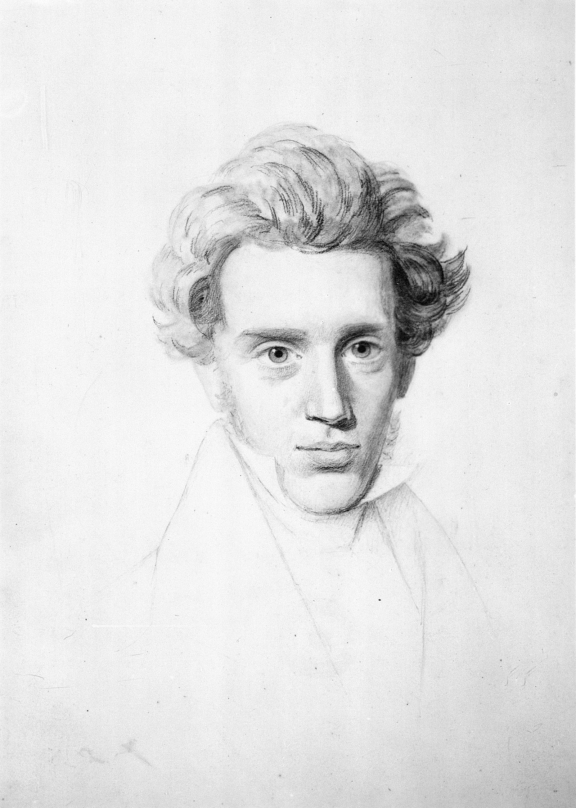
Søren Aabye Kierkegaard

Slide 43
A prodigious scaled thinker erects an immense building, a system, a system which embraces the whole of existence and world-history etc. — and if we contemplate his personal life, we discover to our astonishment this terrible and ludicrous fact, that he himself personally does not live in this immense high-vaulted palace, but in a barn alongside of it, or in a dog kennel, or at the most in the porter’s lodge. If one were to take the liberty of calling his attention to this by a single word, he would be offended. For he has no fear of being under a delusion, if only he can get the system completed... by means of the delusion
Søren Aabye Kierkegaard

Slide 44
A prodigious scaled thinker erects an immense building, a system, a system which embraces the whole of existence and world-history etc. — and if we contemplate his personal life, we discover to our astonishment this terrible and ludicrous fact, that he himself personally does not live in this immense high-vaulted palace, but in a barn alongside of it, or in a dog kennel, or at the most in the porter’s lodge. If one were to take the liberty of calling his attention to this by a single word, he would be offended. For he has no fear of being under a delusion, if only he can get the system completed... by means of the delusion
So then, the fact that the man in despair is unaware that his condition is despair, has nothing to do with the case, he is in despair all the same.
Søren Aabye Kierkegaard

Slide 45
I’m in despair
Søren Aabye Kierkegaard

Slide 46
I’m in despair
The human
- Infinite
- Eternal
- Freedom
Synthesis
- Finite
- Temporal
- Necessity
Søren Aabye Kierkegaard

Slide 47
I’m in despair
The human
A
- Infinite
- Eternal
- Freedom
Synthesis
B
- Finite
- Temporal
- Necessity
Søren Aabye Kierkegaard

Slide 48
I’m in despair
The Self
- Infinite
- Eternal
- Freedom
A
- Infinite
- Eternal
- Freedom
- Infinite
- Eternal
- Freedom
A
- Finite
- Temporal
- Necessity
B
- Finite
- Temporal
- Necessity
- Finite
- Temporal
- Necessity
B
Søren Aabye Kierkegaard

Slide 49
I’m in despair
The Self
- Infinite
- Eternal
- Freedom
A_{t}
- Infinite
- Eternal
- Freedom
A_{b}
Despair
- Finite
- Temporal
- Necessity
B_{t}
- Finite
- Temporal
- Necessity
B_{b}
t = true state
b = belief state
Søren Aabye Kierkegaard

Slide 50
I’m in despair
The Self
- Infinite
- Eternal
- Freedom
A_{t}
- Infinite
- Eternal
- Freedom
A_{b}
Despair
x_{b} = x_{t} + ϵ_{x}
D = [A_{t} , B_{t}] - [A_{t}+ϵ_{A} , B_{t} +ϵ_{B}]
D = ϵ_{A} + ϵ_{B}
- Finite
- Temporal
- Necessity
B_{t}
- Finite
- Temporal
- Necessity
B_{b}
t = true state
b = belief state
Søren Aabye Kierkegaard

Slide 51
I’m in despair
The Self
- Infinite
- Eternal
- Freedom
A
- Infinite
- Eternal
- Freedom
- Infinite
- Eternal
- Freedom
A
- Finite
- Temporal
- Necessity
B
- Finite
- Temporal
- Necessity
- Finite
- Temporal
- Necessity
B
Søren Aabye Kierkegaard

Slide 52
I’m in despair
The Self
- Infinite
- Eternal
- Freedom
A
- Infinite
- Eternal
- Freedom
- Infinite
- Eternal
- Freedom
A
- Finite
- Temporal
- Necessity
B
- Finite
- Temporal
- Necessity
B
Søren Aabye Kierkegaard
GOD

Slide 53
I’m in the nature now?
The Self
- Infinite
- Eternal
- Freedom
A
- Infinite
- Eternal
- Freedom
- Infinite
- Eternal
- Freedom
A
- Finite
- Temporal
- Necessity
B
- Finite
- Temporal
- Necessity
B
Søren Aabye Kierkegaard
NATURE

Slide 54
A_{t}
A_{b}
B_{t}
B_{b}
Things as they are in themselves
Things as they appear for us

Slide 55
A_{t}
A_{b}
What is it like to be a thing?
B_{t}
B_{b}
Things as they are in themselves
Things as they appear for us

Slide 56
A_{t}
A_{b}
What is it like to be a thing?
B_{t}
B_{b}
Things as they are in themselves
Things as they appear for us

Slide 57
”Despite all the science fictional claims to the contrary, the alien is different. One does not ask the alien, “Do you come in peace?” but rather, “What am I to you?” The posture one takes before the alien is that of curiosity, of wonder. For too long, humanists have relinquished wonder to the natural sciences, and then swooped in ostentatiously to blame its awe on false consciousness. The return to realism in metaphysics is also a return to wonder, wonder unburdened by pretense or deception. Let’s leave rigor to the dead. Let’s trade furrows for gasps. Let’s rub our temples at one another no longer. Let’s go outside and dig in the dirt.”
Bogost, Ian. Alien Phenomenology, or What It’s Like to Be a Thing, University of Minnesota Press, 2012.

